Slide 1

Lenz’s Law
This presentation covers the principles of Lenz’s Law, explaining how induced currents oppose changes in magnetic flux, ensuring energy conservation in electromagnetic systems.
Muhammad Taha
25F-069
Physics
Dr.Ilyas Abro
OCTOBER 2025

Slide 2
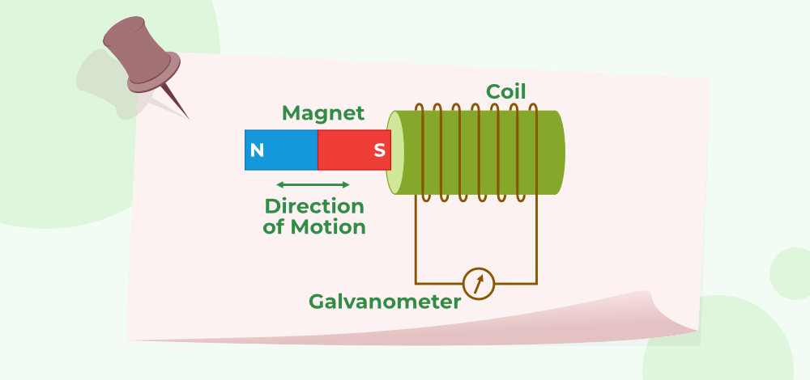
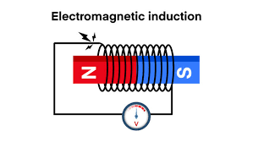
Understanding Electromagnetic Induction and Lenz’s Law
HOW CHANGING MAGNETIC FLUX CREATES INDUCED CURRENT AND ITS IMPLICATIONS
Electromagnetic induction arises from changing magnetic flux, which induces an electromotive force (EMF) in a conductor. Lenz’s Law states that the direction of the induced current opposes the change in flux, ensuring energy conservation and influencing various applications in modern technology. This foundational principle underpins many electromagnetic systems.

Slide 3
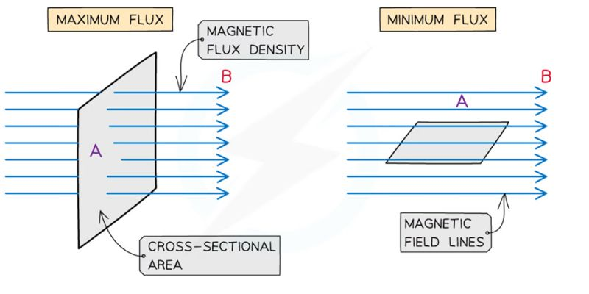
Magnetic Flux (Φ) Explained
“Magnetic flux represents the number of magnetic field lines passing through a surface.”
Formula : Φ = B × A × cosθ
Magnetic flux (Φ) is defined as the product of the magnetic field strength (B), the area (A) through which it passes, and the cosine of the angle (θ) between the magnetic field and the normal to the surface. This concept is crucial for analyzing electromagnetic induction and understanding how changes in magnetic flux can induce current.

Slide 4
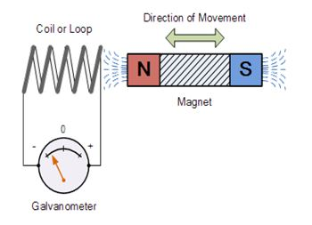
History of Lenz’s Law
“In 1831, Michael Faraday discovered electromagnetic induction — that changing magnetic field produces electric current.”
“In 1834, Heinrich Lenz defined the direction of the induced current, known as Lenz’s Law.”
“Together, Faraday and Lenz explained how electricity is generated from magnetism.”

Slide 5
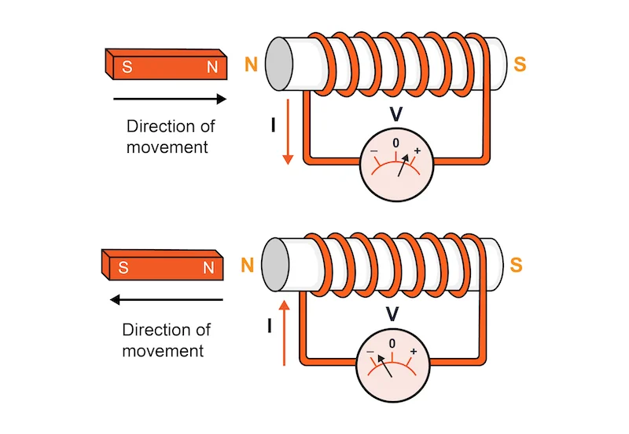
Understanding Lenz’s Law
“The direction of an induced current is such that its magnetic field opposes the change in magnetic flux that produced it.”
– LENZ’S PRINCIPLE

Slide 6
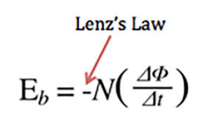
Mathematical Expression of Lenz’s Law
Understanding the formula ε = −N dΦ/dt and its significance
ε = induced emf
N = number of turns
Φ = magnetic flux
‘−’ sign shows opposition

Slide 7
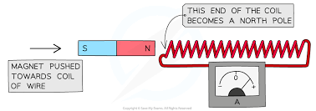
Example 1: Magnet Approaches Coil
Magnetic flux increases.
Coil produces a magnetic field opposing the magnet.
Coil face becomes North Pole (repels magnet).

Slide 8
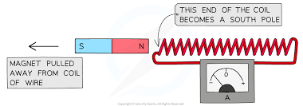
Example 2: Magnet Moves Away from Coil
Magnetic flux decreases.
Coil produces field that attracts the magnet.
Coil face becomes South Pole (attracts magnet).

Slide 9
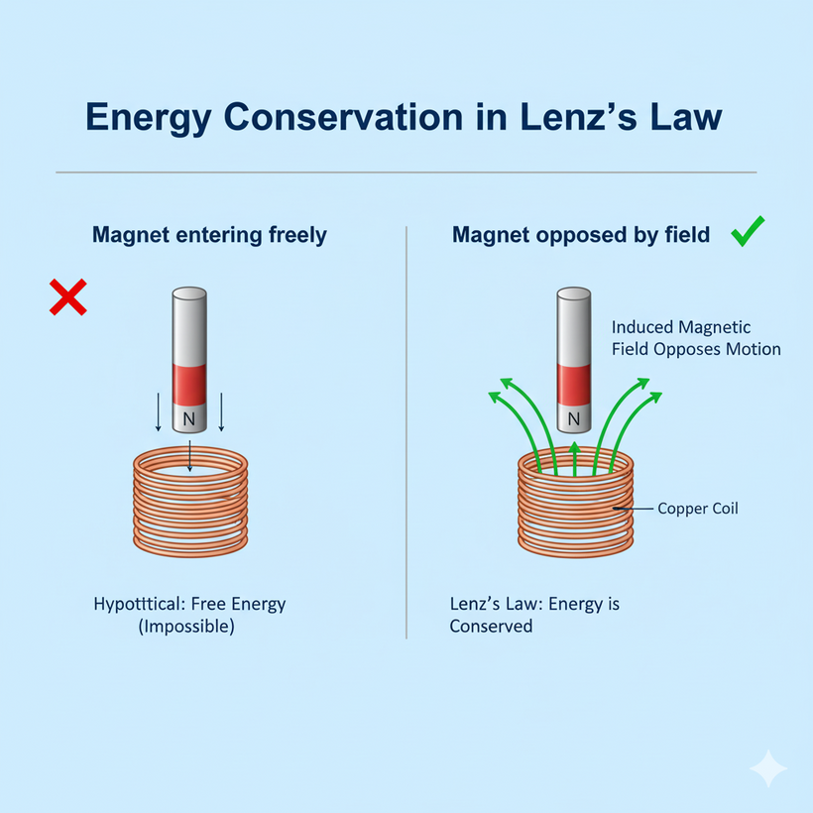
Energy Conservation in Lenz’s Law
“If induced current did not oppose flux change, the magnet would move freely.”
“This would create free energy — which is impossible.”
“Lenz’s Law ensures that energy is always conserved.”

Slide 10
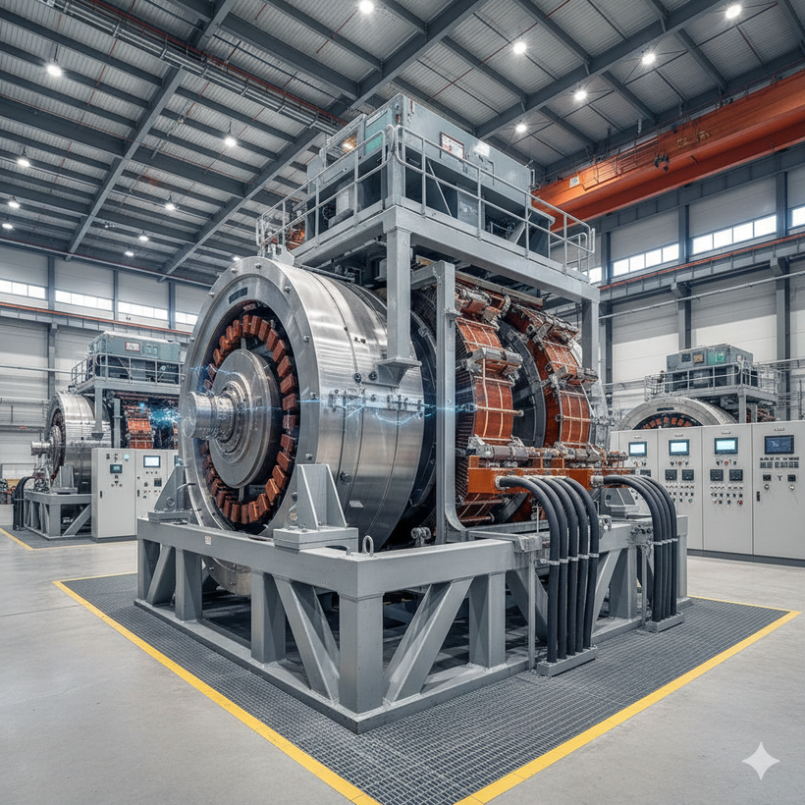


Applications of Lenz’s Law in Technology
ELECTRIC GENERATORS
Convert mechanical energy into electrical energy.
INDUCTION COOKERS
Eddy currents heat the metal vessel.
MAGNETIC BRAKING
Used in trains and roller coasters.

Slide 11
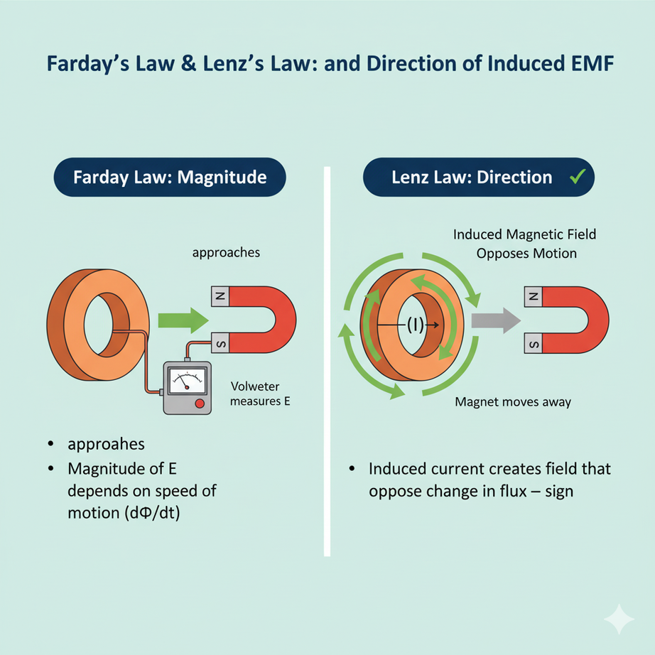
Connection with Faraday’s Law
“Faraday’s Law gives the magnitude of induced emf: ε = N dΦ/dt.”
“Lenz’s Law adds the negative sign showing direction and opposition.”
“This negative sign ensures conservation of energy.”

Slide 12
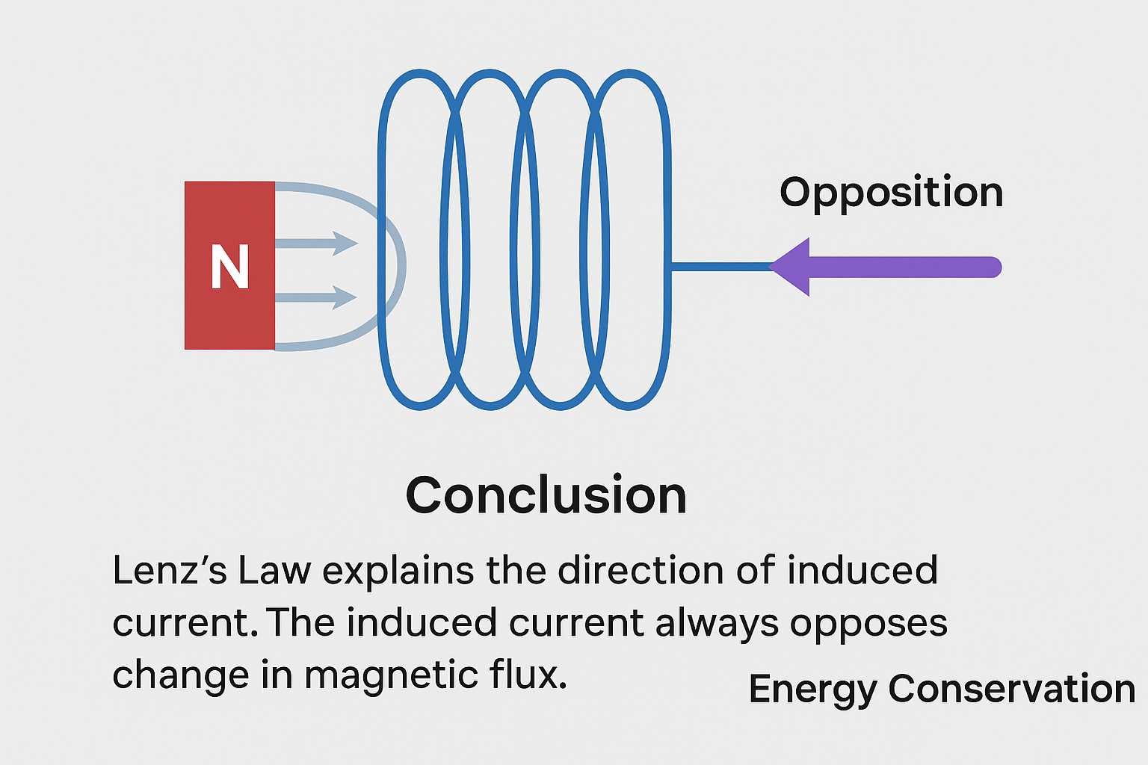
Conclusion:
“Lenz’s Law explains the direction of induced current.”
“The induced current always opposes change in magnetic flux.”
“It ensures energy conservation and forms the basis of modern electrical technology.”

